Slide 1
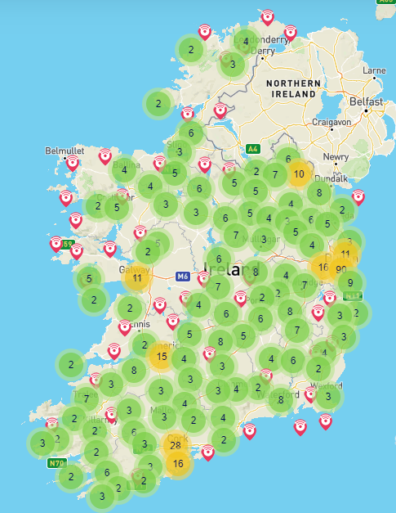





What is eduroam?
eduroam is a Wi-Fi service which enables students, researchers and staff from participating institutions to securely access the internet at their college/university and whilst visiting other participating institutions.
Safe & secure
Easy to use
500+ locations in Ireland
100+ countries
Visit eduroam in Ireland page on www.eduroam.ie to find your nearest hotspots or scan the QR code

